Slide 1
The Apology (2008)
Year 10 History- Rights and Freedoms

Slide 2
The Stolen Generations
The forced removal of over 100 000 Aboriginal and Torres Strait Islander children
Children were taken from their families and placed into the care of government institutions, or adopted by non-Indigenous families
Occurred from 1860’s – 1970’s
Children of both Western (white) and Aboriginal descent, commonly referred to as ‘half-caste’, were sent to missions or reserves to be taught European ways
*“half-caste” is now considered a derogatory term*

Slide 3
Why were children removed?
This was done legally and they justified them as protecting the interests of the children
It was believed that ‘half-caste’ children were disadvantaged and should receive a civilised upbringing
It was thought that if the children assimilated into Western culture, their Aboriginality would be ‘bred out’ of them.
Archie Roach – Took the Children away https://www.youtube.com/watch?v=R3FPc72ntY0

Slide 4
Impact
Children faced ongoing emotional and social difficulties
Many children ended up being rejected from both the Aboriginal and European communities
Many experienced physical and emotional abuse in the missions
Quote: “Most of us girls were thinking white in the head but were feeling black inside. We were a very lonely, lost and sad group of people”. “We didn’t know anything about our culture”. -Extract from the Bringing them Home Report, 1996.

Slide 5
Reconciliation
A term used to refer to the bringing together of Indigenous and non-Indigenous Australians
It is a process that involves working to overcome past divisions and addresses inequalities between Indigenous and non-Indigenous Australians.
A continuing process, not a single event
Popular support for the Stolen Generations grew around the end of the 1990’s.

Slide 6
The Apology to the Stolen Generations
In 2008, Kevin Rudd apologised to Indigenous Australians for poor or unwise treatment from the time of European settlement through to recent years.
It was on behalf of the whole nation and recognised that Indigenous Australians had been wronged.
Parliament was packed, and many gathered in public spaces, schools, offices all over the country to view this.

Slide 7
Many Indigenous Australians had died without hearing these words.
A ‘turning point’ in Australian history.,
Many prominent Aboriginal Rights leaders were in Parliament.

Slide 8
Video
https://www.youtube.com/watch?v=_Dild-xAzJ0

Slide 9
Questions
1. What does he say sorry for?
2. Who is he apologising on behalf of?
3. What kinds of effects was the apology meant
to have?
4. Do you think these impacts were achieved?
5. How do you think the apology affected Aboriginal and Torres Strait Islander people?

Slide 10
Speech Transcript
Prime Minister (Hon Kevin Rudd MP): Mr Speaker, I move:
That today we honour the Indigenous peoples of this land, the oldest continuing cultures in human history.
We reflect on their past mistreatment.
We reflect in particular on the mistreatment of those who were Stolen Generations - this blemished chapter in our nation's history.
The time has now come for the nation to turn a new page in Australia's history by righting the wrongs of the past and so moving forward with confidence to the future.
We apologise for the laws and policies of successive Parliaments and governments that have inflicted profound grief, suffering and loss on these our fellow Australians.
We apologise especially for the removal of Aboriginal and Torres Strait Islander children from their families, their communities and their country.
For the pain, suffering and hurt of these Stolen Generations, their descendants and for their families left behind, we say sorry.
To the mothers and the fathers, the brothers and the sisters, for the breaking up of families and communities, we say sorry.
And for the indignity and degradation thus inflicted on a proud people and a proud culture, we say sorry.
We the Parliament of Australia respectfully request that this apology be received in the spirit in which it is offered as part of the healing of the nation.
For the future we take heart; resolving that this new page in the history of our great continent can now be written.
We today take this first step by acknowledging the past and laying claim to a future that embraces all Australians.
A future where this Parliament resolves that the injustices of the past must never, never happen again.
A future where we harness the determination of all Australians, Indigenous and non-Indigenous, to close the gap that lies between us in life expectancy, educational achievement and economic opportunity.
A future where we embrace the possibility of new solutions to enduring problems where old approaches have failed.
A future based on mutual respect, mutual resolve and mutual responsibility.
A future where all Australians, whatever their origins, are truly equal partners, with equal opportunities and with an equal stake in shaping the next chapter in the history of this great country, Australia.

Slide 11
Why did he apologise?
Bringing Them Home Report
Third recommendation of the 1997 BTH Report which stated that ‘reparation be made in recognition of the history of gross violations of human rights’
In the report, this was broken down into 5 key components
Acknowledgement and apology
Guarantees against repetition
Measures of restitution
Measures of rehabilitation
Monetary compensation

Slide 12
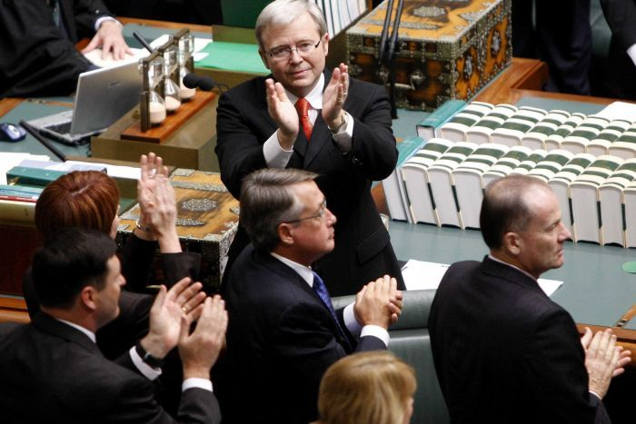
Kevin Rudd applauds members of Australia’s Stolen Generation

Slide 13
Initial Response
Opinion polls showed that a significant number of Australians rated it as ‘excellent’, ‘good’, or ‘great’.
Major criticism: no mention of compensation for those affected.
Some saw it as meaningless unless it was immediately accompanied by practical measures to remove Aboriginal and Torres Strait Islander disadvantage and implement true reconciliation
Although an official apology was a necessary step, leaders argue that these practical measures are needed to ensure that Indigenous Australians are on equal footing with other Australians.

Slide 14
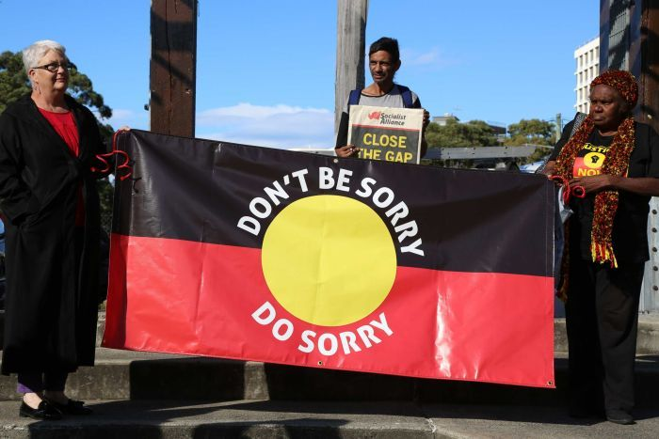

Slide 15
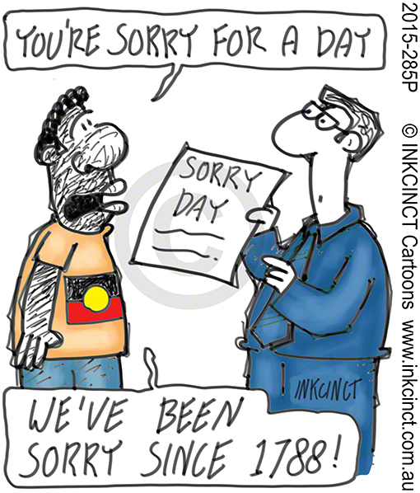

Slide 16
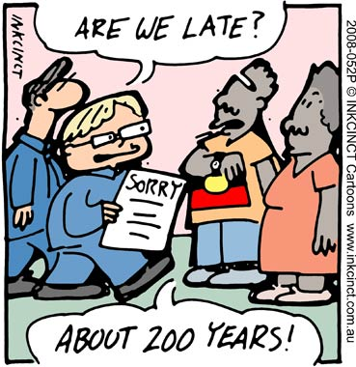

Slide 17
Today
During the National Apology to Stolen Generations, the words "The First Step" were written in giant letters on the lawn of Parliament House. The decade that has followed could perhaps be summed up as "one step forward, two steps back". ABC News
https://www.youtube.com/watch?v=kINrWURyd90

Slide 18
Closing The Gap
In 2008, Australian Governments committed to specific targets for reducing inequalityes in ATSI life expectancy, mortality, education, school attendance and employment.
Close the gap in life expectancy by 2031
Halve the gap in child mortality by 2018
Ensure 95 percent of Aboriginal and Torres Strait Islander four-years-olds are enrolled in early childhood education by 2025
Halve the gap in reading, writing and numeracy by 2018
Halve the gap in year 12 attainment by 2020
Halve the gap in employment by 2018.
Close the gap in school attendance by 2018

Slide 19
Closing The Gap
In 2008, Australian Governments committed to specific targets for reducing inequalityes in ATSI life expectancy, mortality, education, school attendance and employment.
Close the gap in life expectancy by 2031
Halve the gap in child mortality by 2018
Ensure 95 percent of Aboriginal and Torres Strait Islander four-years-olds are enrolled in early childhood education by 2025
Halve the gap in reading, writing and numeracy by 2018
Halve the gap in year 12 attainment by 2020 – On Track
Halve the gap in employment by 2018.
Close the gap in school attendance by 2018

